Slide 1
How Do I Receive a Citation for Historian/Media Relations?
Create a 3-5 minute video on your phone chatting with a legacy (long-time) member of your Auxiliary.
Send the Historian/Media Relations Award form and the recording to me (mtnnan2@gmail.com).
Deadline is March 31, 2024.

Slide 3
How Do I Create the Video?
Determine who you want to interview; who has been a member of the VFW Auxiliary for a long-time; are they willing to participate. This individual does not have to have been a long-time member of your specific; just a long time Auxiliary member.
Formulate your questions: name, Auxiliary name and number, how long have they been a member; why did they join and under whose VFW membership did they join; what is your favorite part about being a member; what is your favorite memory as a member; what do you hope to accomplish through your membership? Keep your questions simple and straightforward…not too wordy and to the point!

Slide 4
How Do I Create the Video - continued?
Using your phone’s “Camera” application select the “Video” function. Either place the phone on the table in front of your subject or hold it aimed at your subject…whichever is easiest for your and your member. I’m demonstrating on an Android; I-Phones may be a bit different placement.
Ask the questions you have developed. This should be a very relaxed, “comfortable” type of chat, but free of distractions and noise.
Once your interview has been completed, stop the recording. Your video will appear in the “Photos” application…just like the pictures you take on your phone.
Attach it to the email you are sending to me or if too large, you can use wetransfer.com to send it and by gosh….you are done!
Congratulations—now let’s do it together on your phone!!!

Slide 5
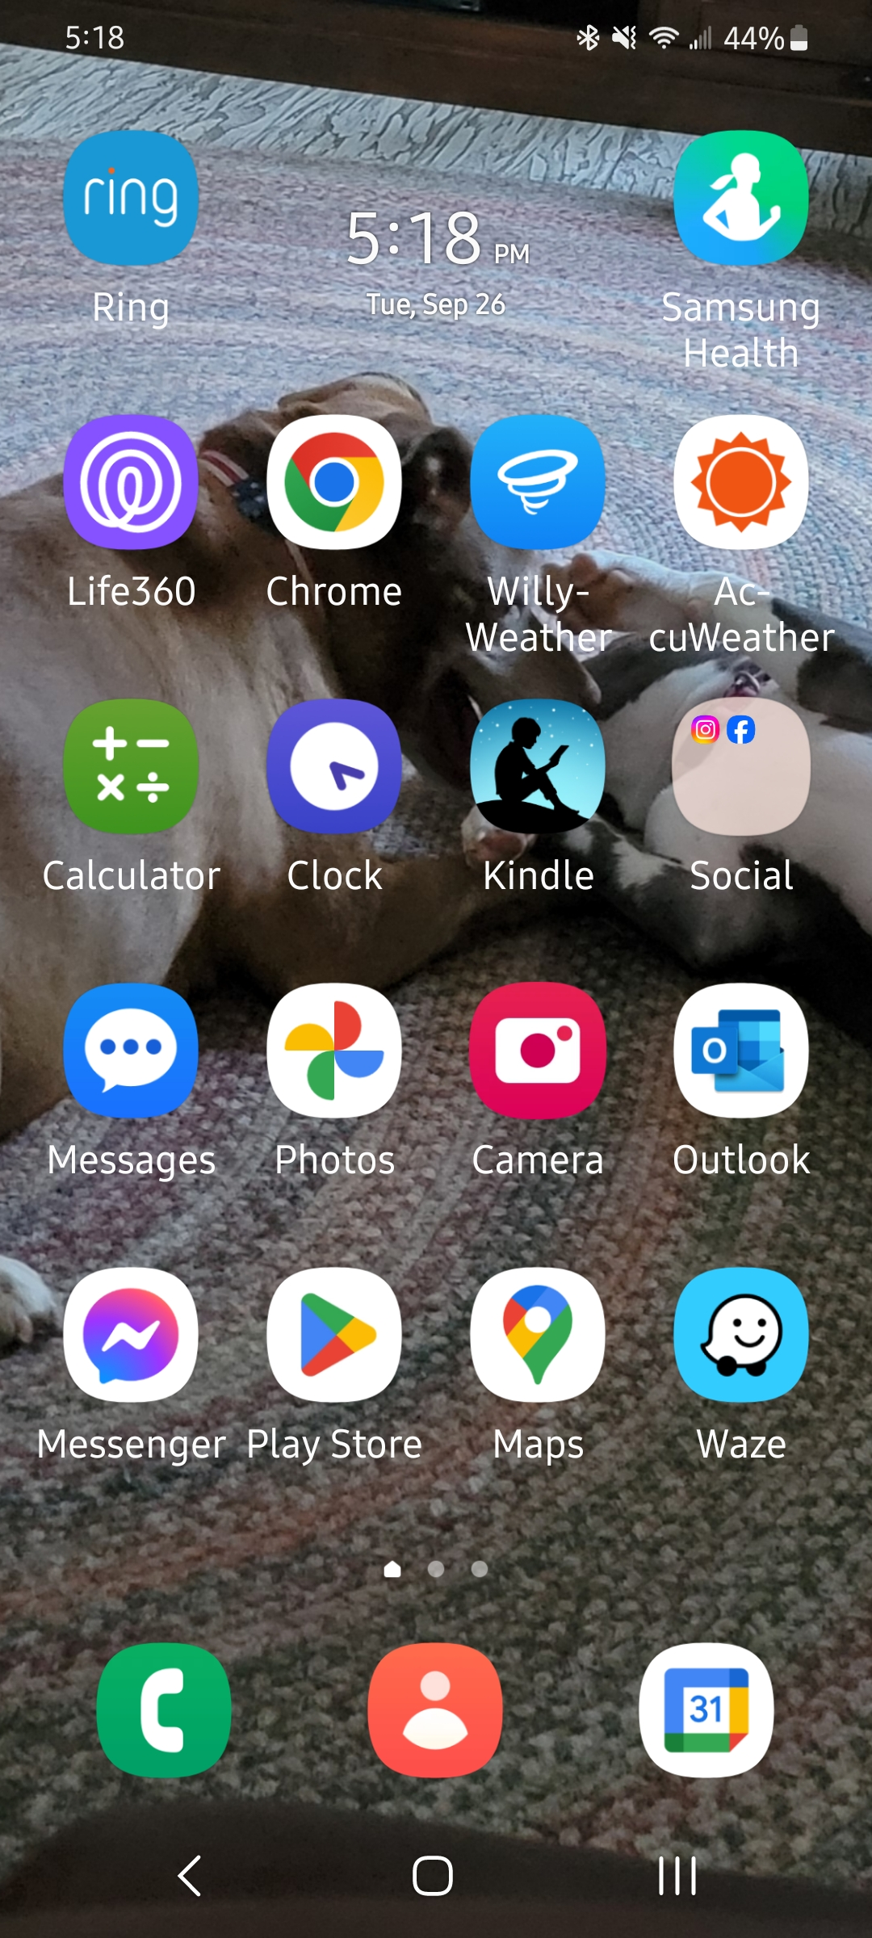

Slide 6
Questions????
Reach out to me…Nancy Schatz
Call or text me at 760-221-0549
Email me at mtnnan2@gmail.com
REMEMBER—the deadline is March 31, 2024.

